Slide 1

Steps for searching fires data from MODIS
By: Dr. Jun Wang & Dr. Lorena Castro García
July 10, 2017

Slide 2
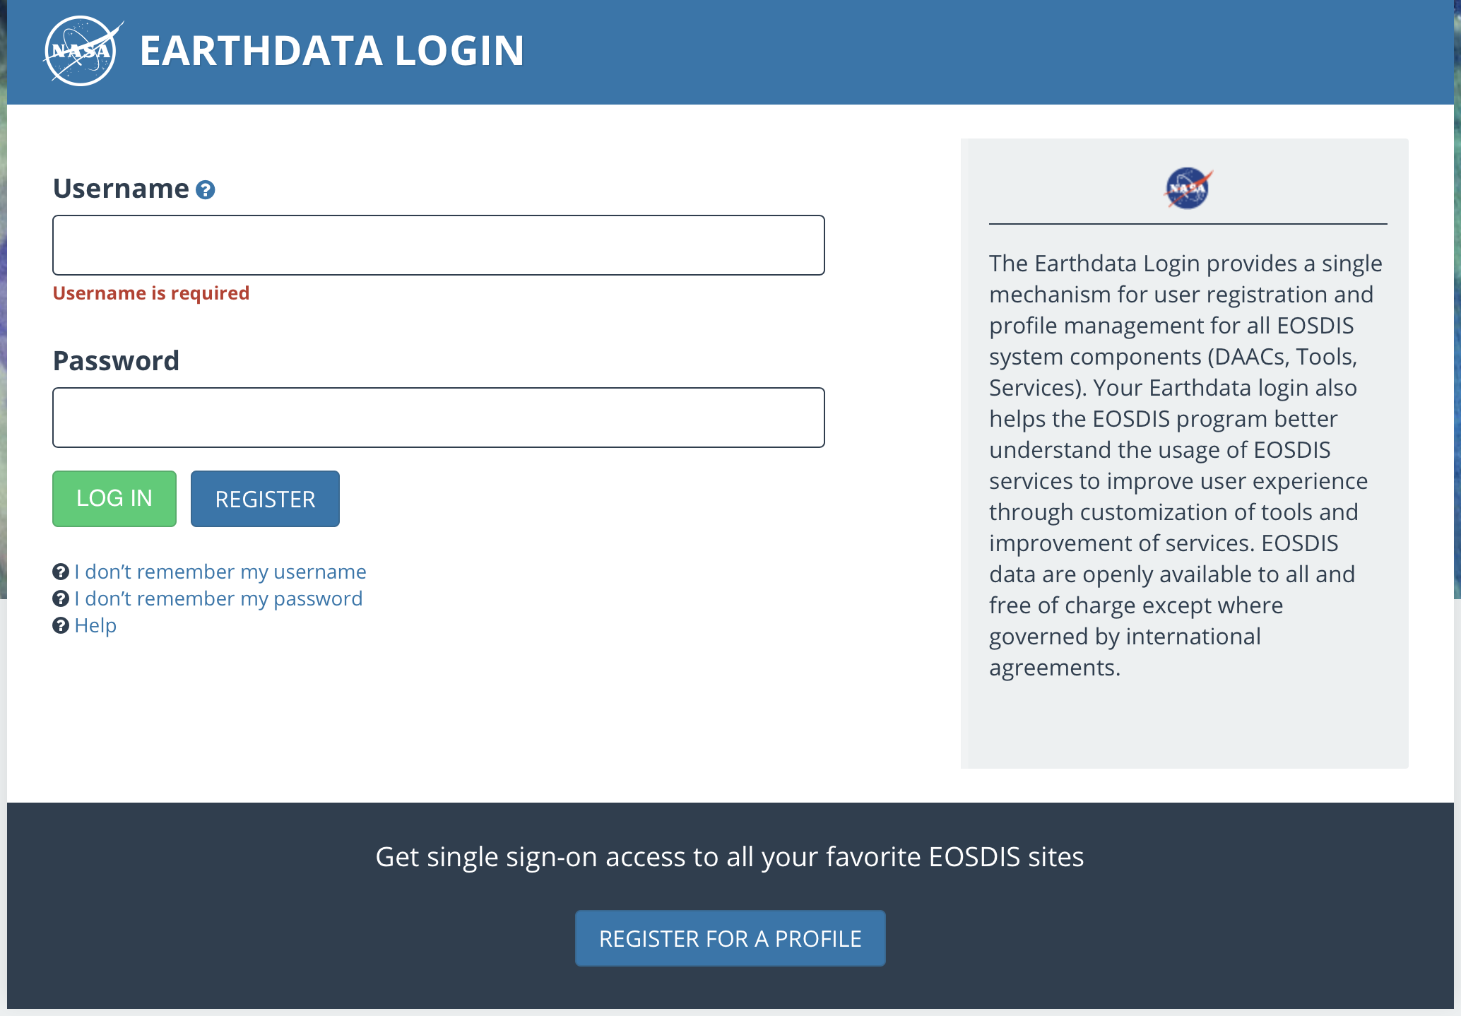
User account
Create a user account at LAADS DAAC website https://urs.earthdata.nasa.gov

Slide 3
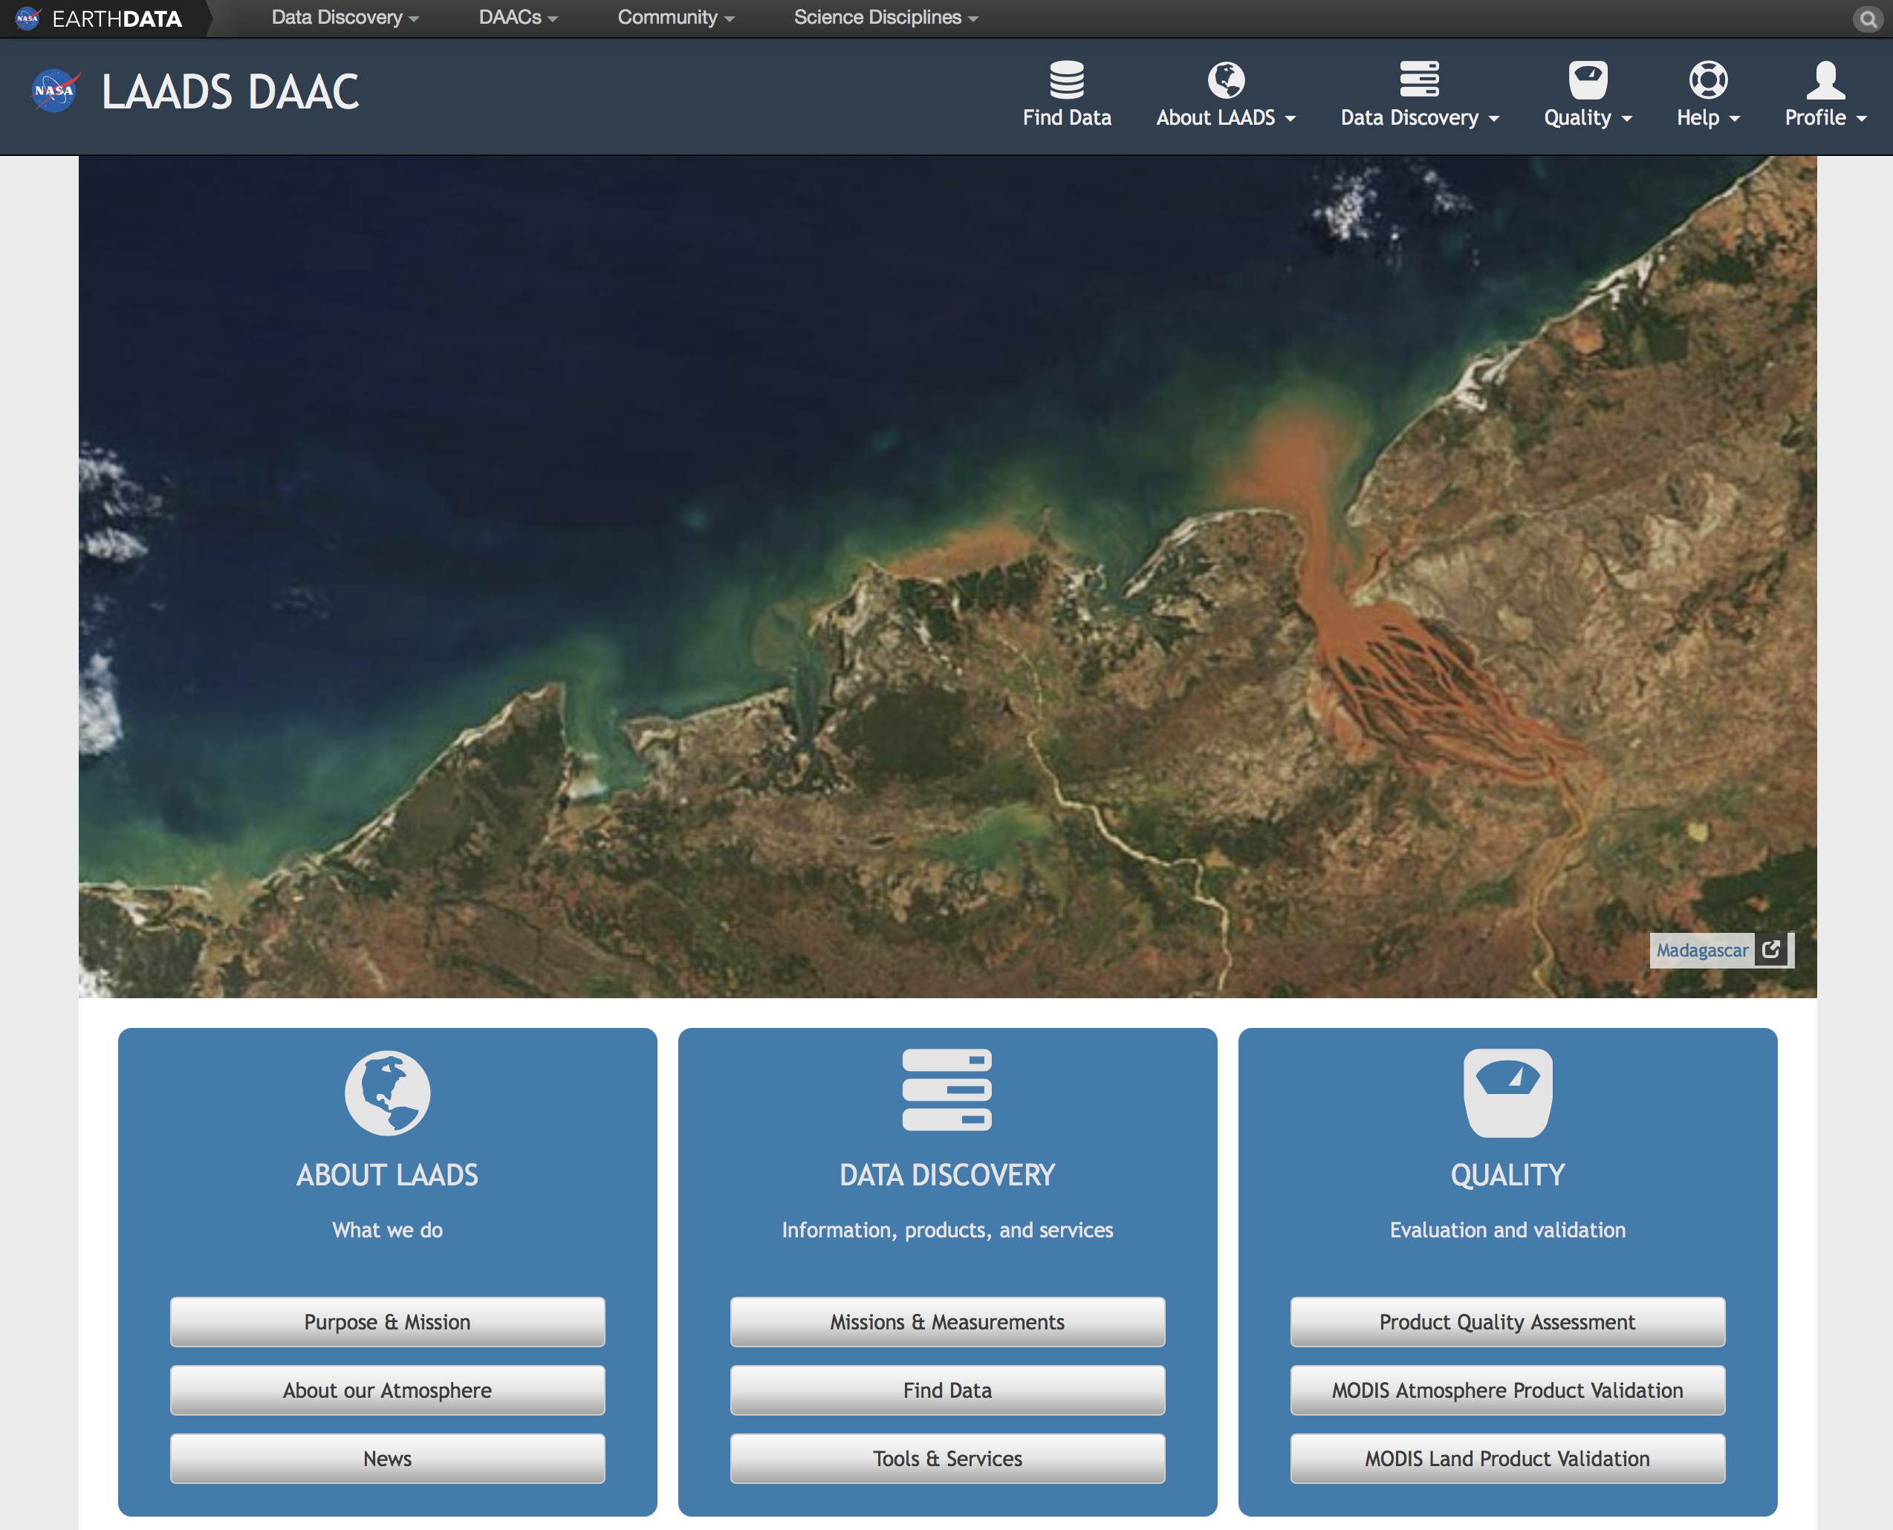
Discovery data
Visit the website of LAADS DAAC
https://ladsweb.modaps.eosdis.nasa.gov
and select “Find data”

Slide 4
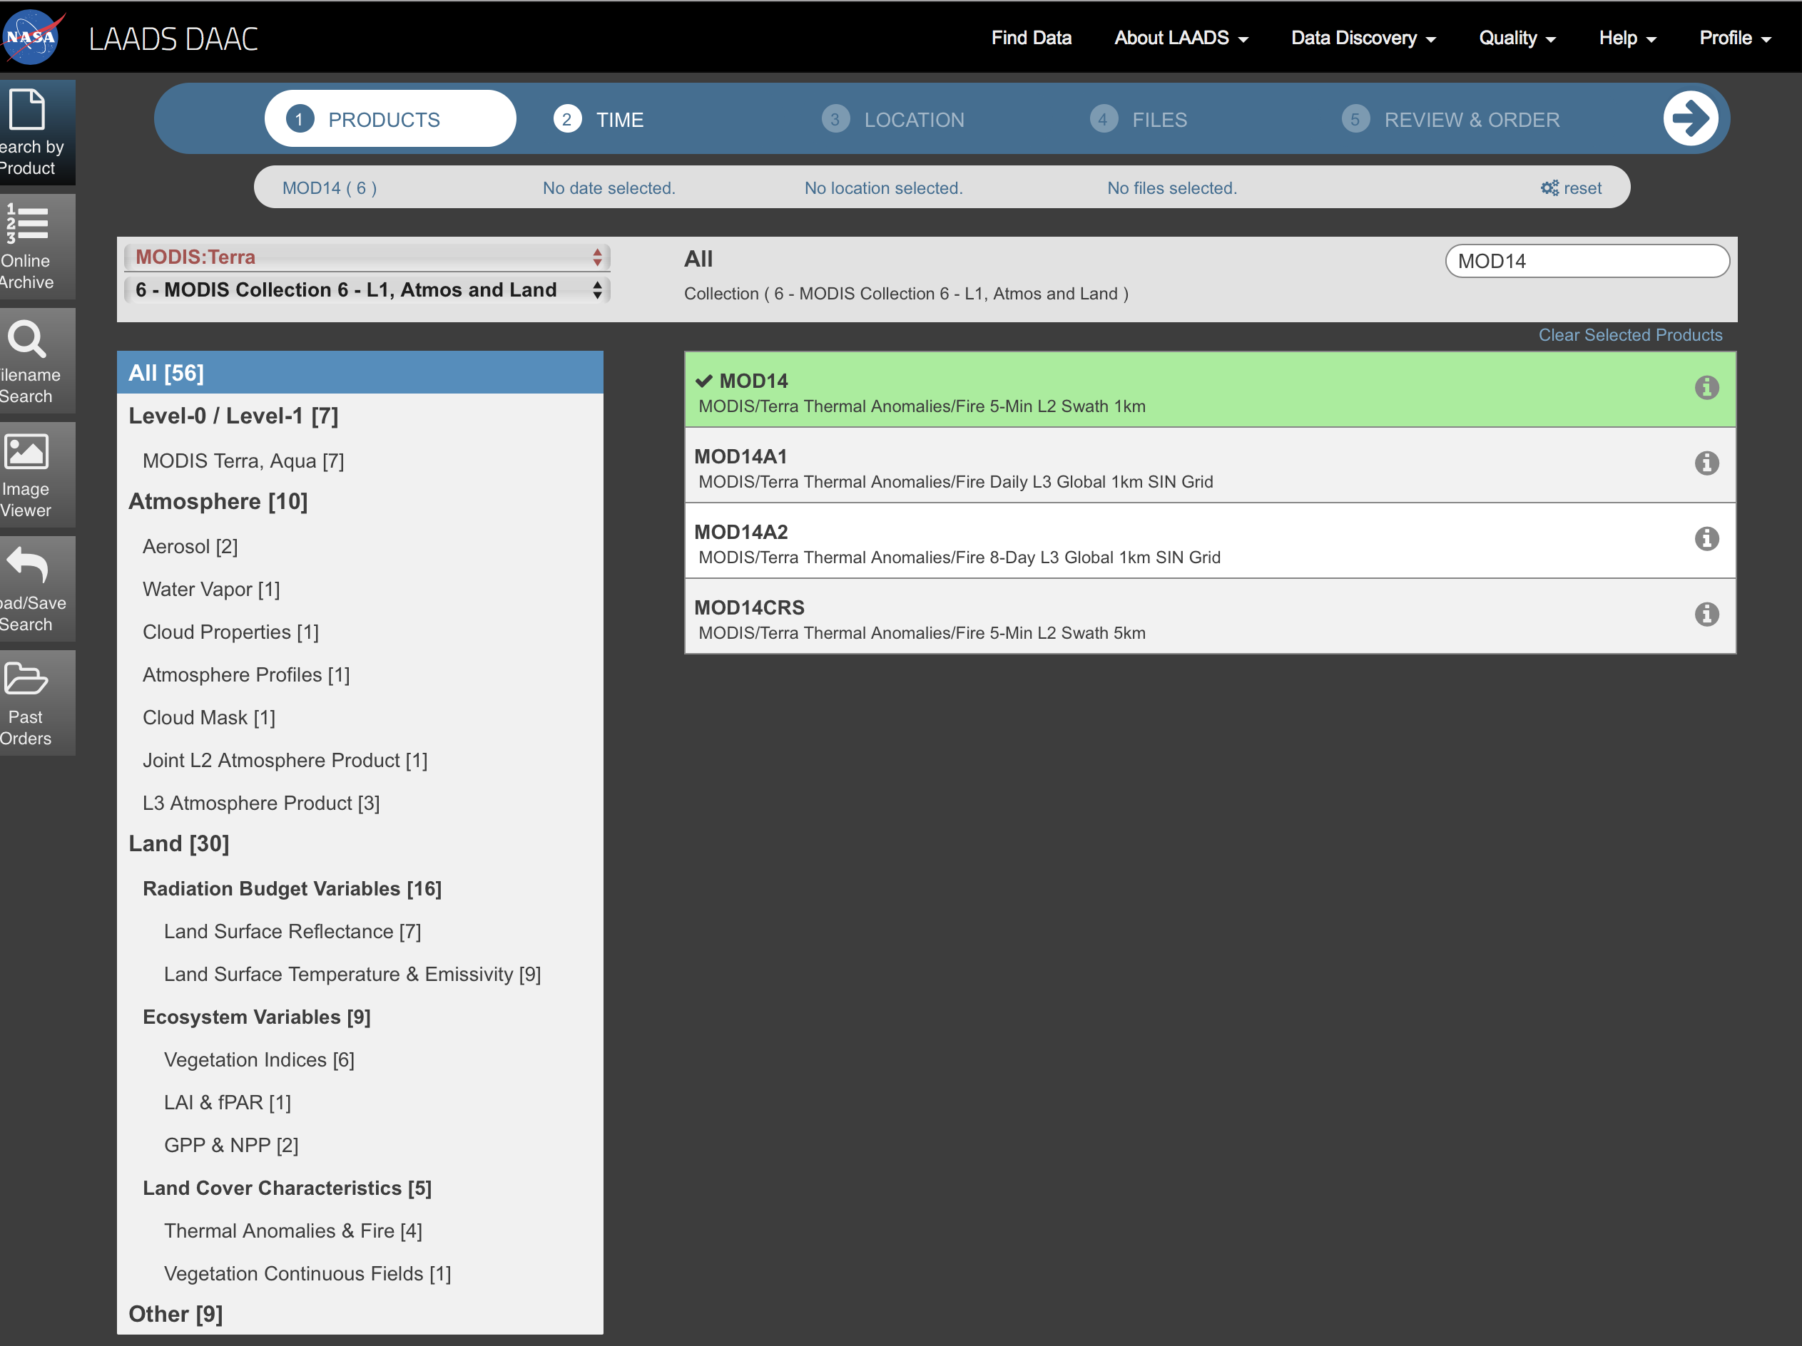
Products
Select interest product
sensor: MODIS terra
collection: Modis Collection6
product: MOD14 and MOD03

Slide 5
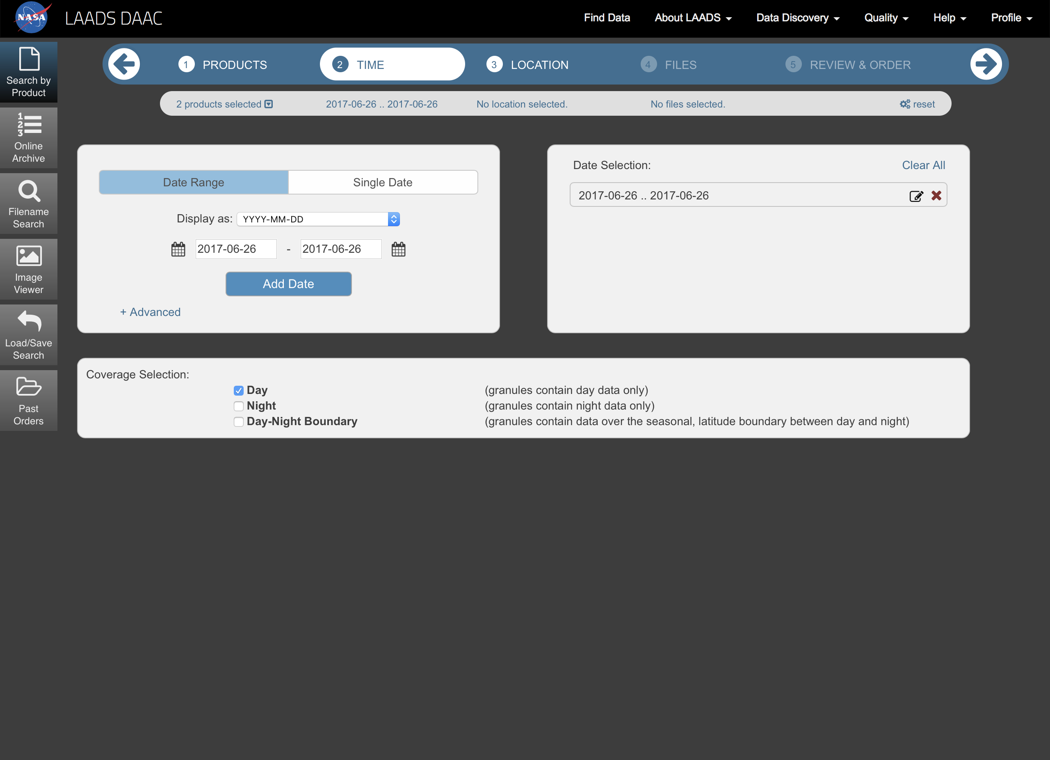
Time
Select period of time and coverage

Slide 6
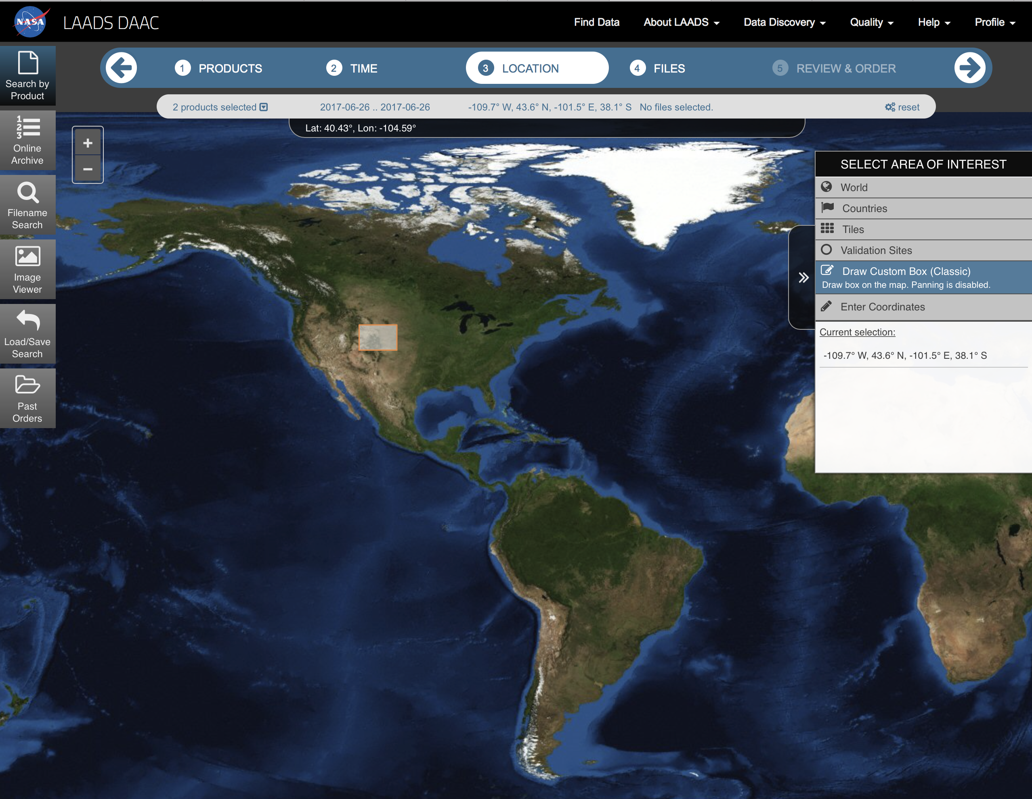
Location
Select Area of interest
In this case, we opted by using the Draw Custom Box tool for selecting our area of interest

Slide 7
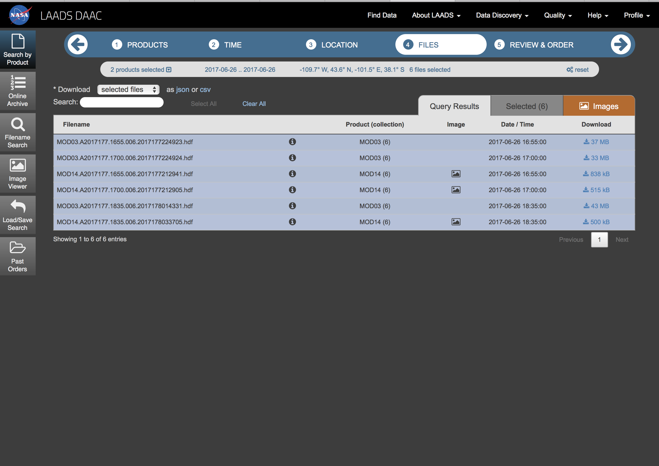
Files
Select files to download
At this point, you can download each file by separately , or you can order all the selected files to download them via FTP.
Note that in the result appears files for MOD14 and MOD03, this is because MOD03 product contains geolocation data for MOD14 .

Slide 8
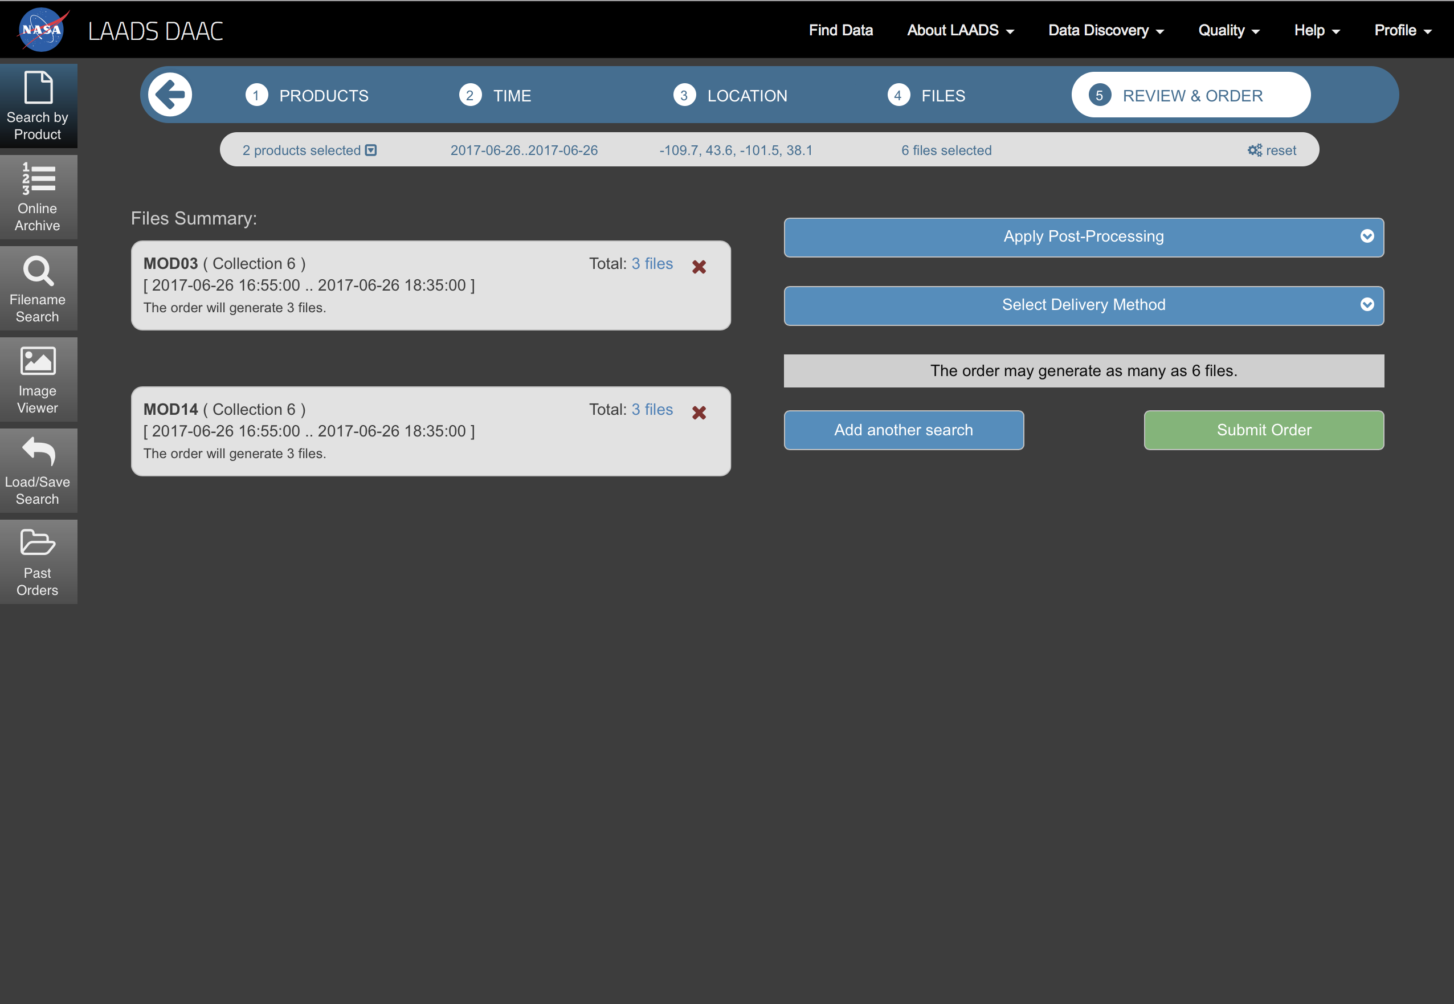
Order
Order files
You will receive an email with the information and instructions for retrieving the files using the command line.

Slide 9
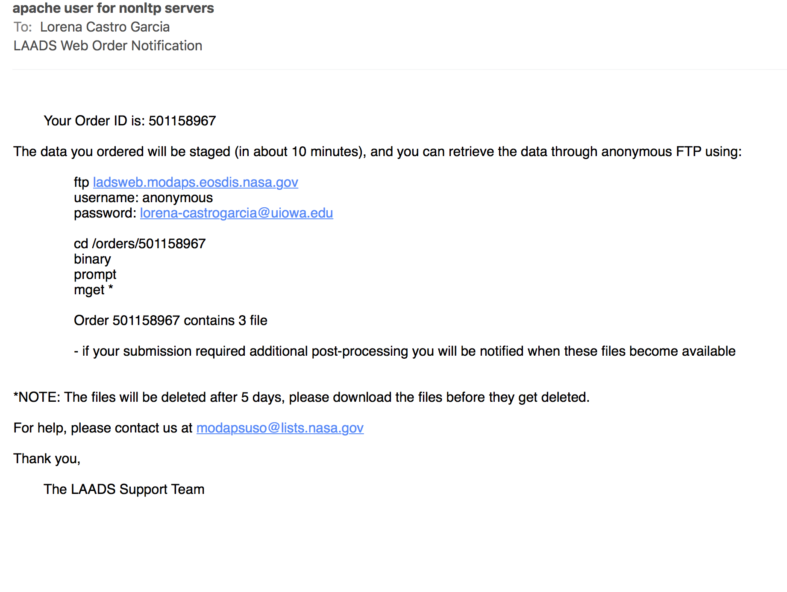
Email instructions
Retrieve files

Slide 10
Contact information
Jun Wang, Professor, Univ. of Iowa;
Phone: 319-353-4483
Center for Global and Regional Environmental Research &
Dept. of Chemical and Biochemical Engineering &
Interdisciplinary Graduate Program in GeoInformatics
4133 Seamans Center, Iowa City, IA 52242-1503
http://arroma.uiowa.edu
Email: jun-wang-1@uiowa.edu
Lorena Castro García (PhD)
Postdoctoral Research Associated
Chemical and Biochemical Engineering &
Center for Global and Regional Environmental Research
University of Iowa
Office: 402 IATL
Email: lcastrogarcia@uiowa.edu

